Slide 1
Byte & Character Streams
OOPS with Java Programming
Unit 2
BCS-403

Slide 2
Byte Streams - What They Are
Byte streams handle raw 8-bit data.
They are used for:
Images
Audio files
PDFs
Any binary file

Slide 3
Byte Streams - Core Classes
InputStream (abstract)
OutputStream (abstract)
FileInputStream
FileOutputStream

Slide 4
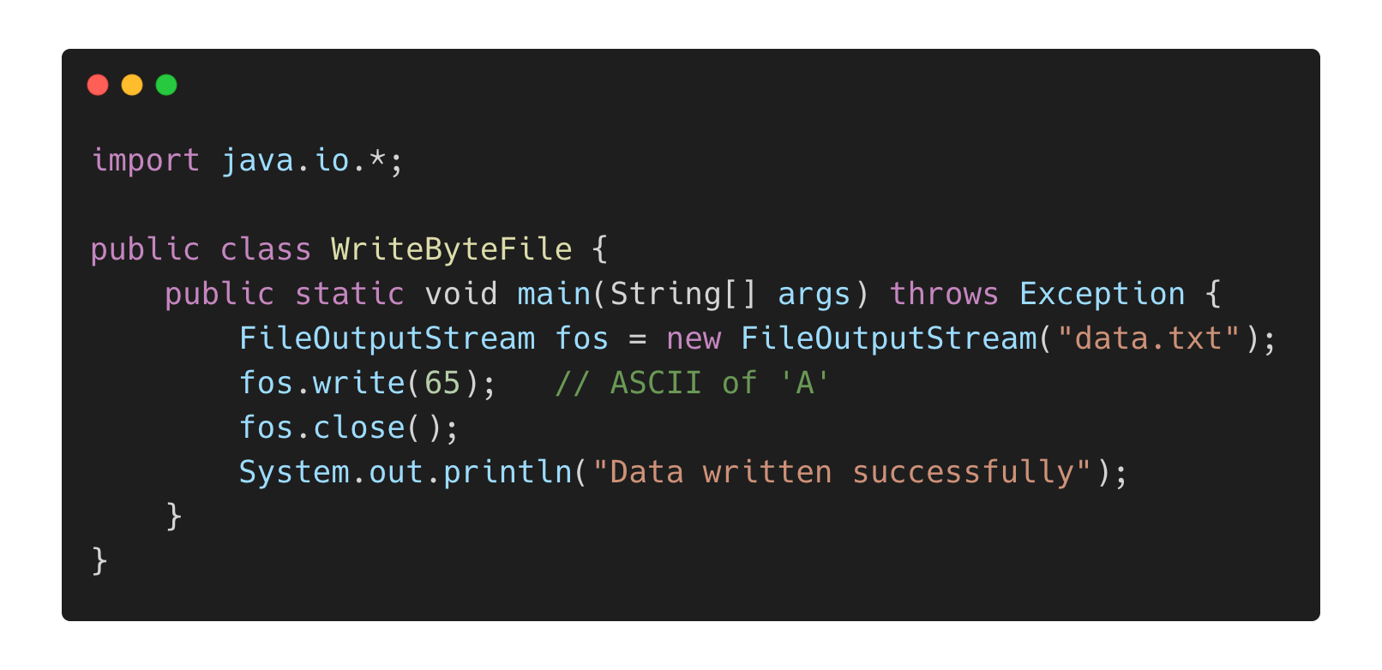
Example: Writing Binary Data

Slide 5
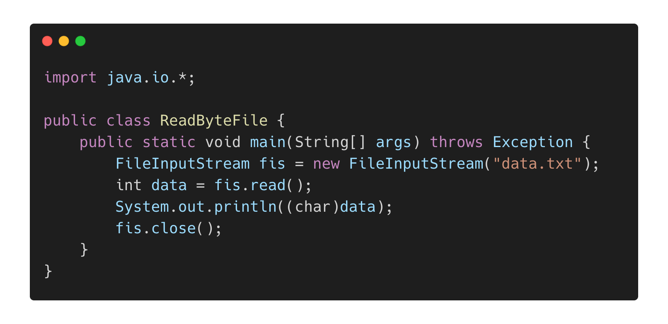
Example: Reading Binary Data

Slide 6
Character Streams - What They Are
Character streams handle 16-bit Unicode characters.
They are used for:
Text files
Reading/writing strings
Handling international characters

Slide 7
Character Streams - Core Classes
Reader (abstract)
Writer (abstract)
FileReader
FileWriter
BufferedReader
BufferedWriter

Slide 8
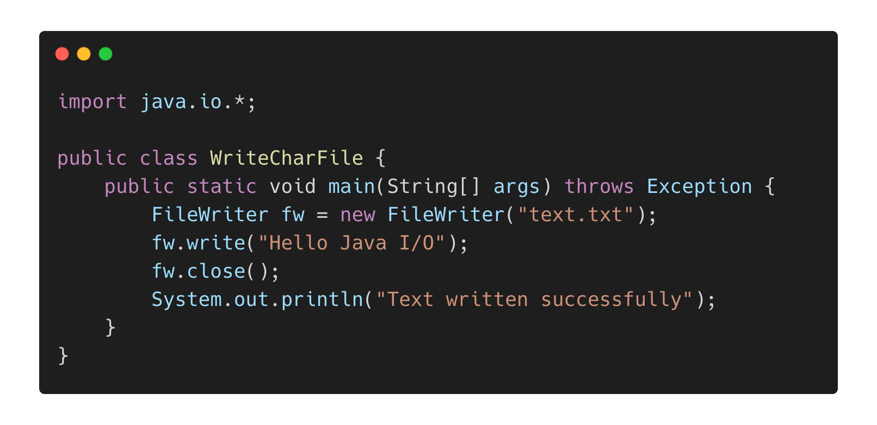
Example: Writing Text File

Slide 9
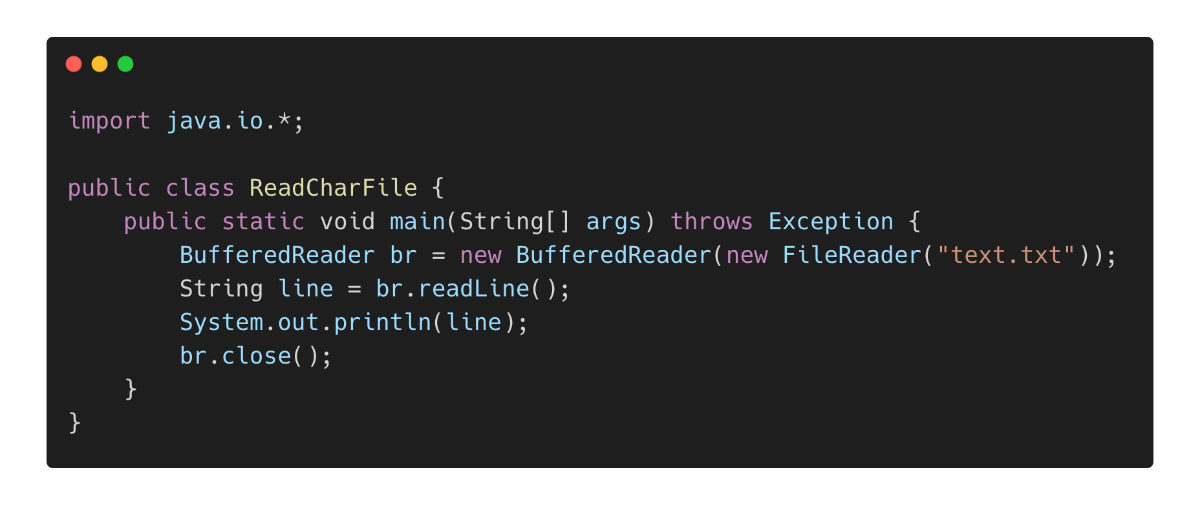
Example: Reading Text File

Slide 10
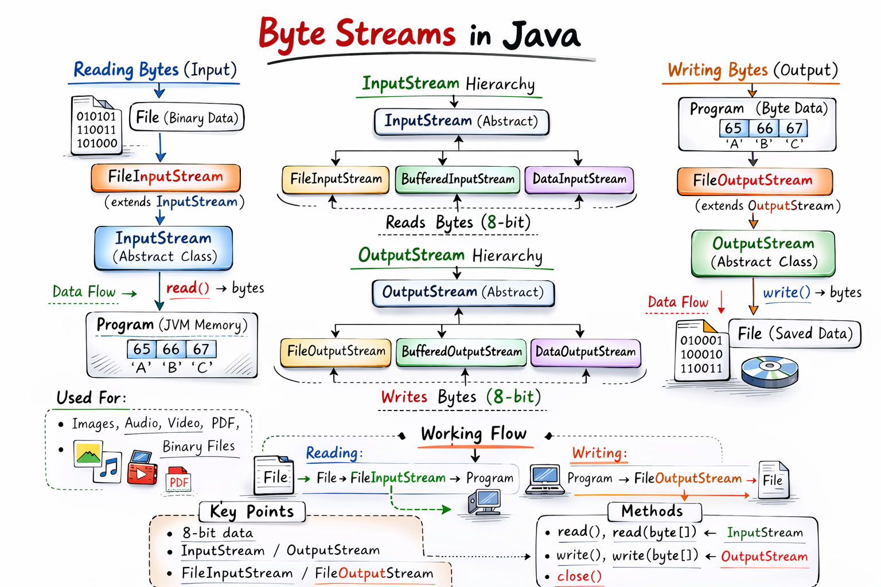

Slide 11
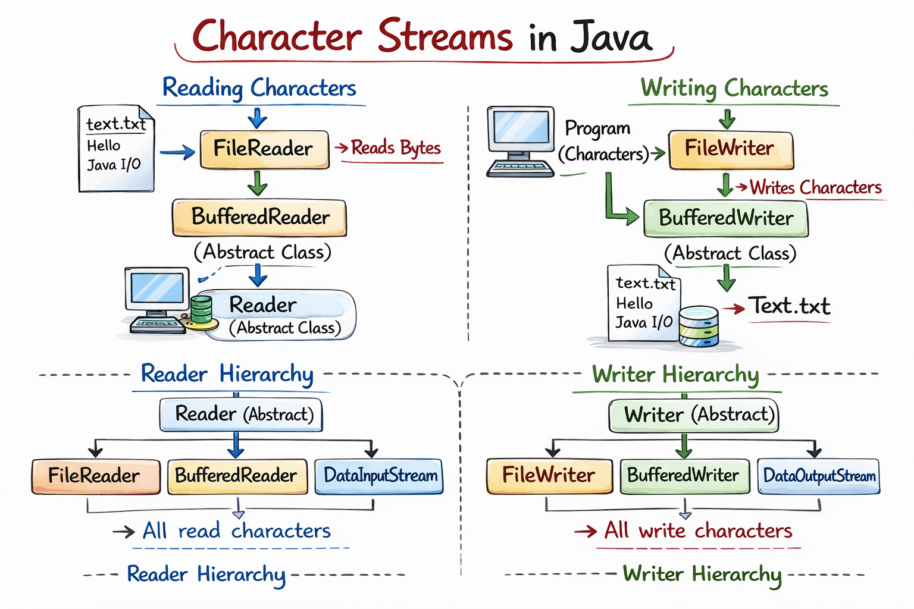

Slide 12
Byte Stream vs Character Stream
Feature | Byte Stream | Character Stream
Data Type | 8-bit | 16-bit Unicode
Base Class | InputStream | Reader
Used For | Binary files | Text files
Example Classes | FileInputStream | FileReader
Performance | Fast for binary | Best for text
If you are dealing with text → use Character Streams
If you are dealing with images/audio/PDF → use Byte Streams

Slide 13
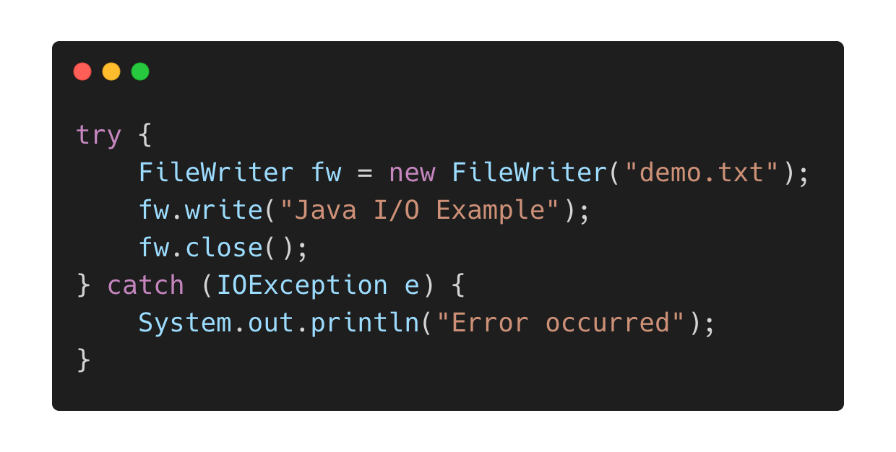
Important Concepts
write() Method
Writes single byte or character
Can write arrays
Exception Handling (Best Practice)
read() Method
Returns integer
Returns -1 at end of file

Slide 14
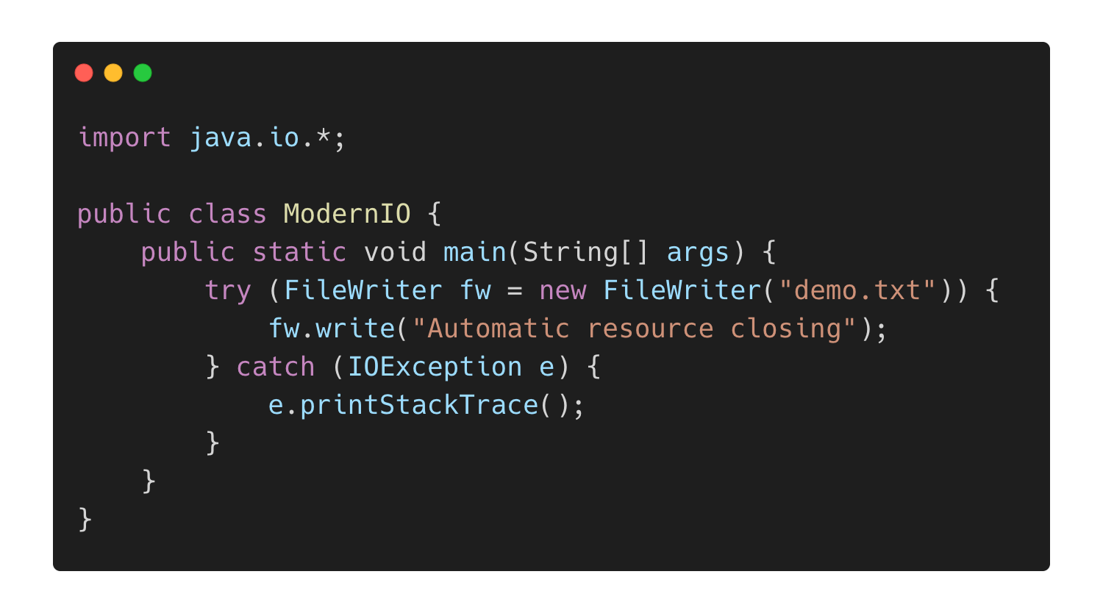
Modern Approach

Slide 15
Interview-oriented points
Students must know:
Difference between FileReader and BufferedReader
Why buffering improves performance?
What happens if file does not exist?
Checked Exception (IOException)
What is EOF?

